Slide 1
Project „ACH“ (Applied Crypto Hardening)
www.bettercrypto.org

Slide 2

Motivation
(Aaron)

Slide 3
Don‘t give them anything for free
It‘s your home, you fight

Slide 4
TL;DR - Quickinfos
Website: www.bettercrypto.org
Git repo: https://git.bettercrypto.org
Mailing list: http://lists.cert.at/cgi-bin/mailman/listinfo/ach

Slide 5
Idea
Do at least something against the Cryptocalypse
Check SSL, SSH, PGP crypto Settings in the most common services and certificates:
Apache, Nginx, lighthttp
IMAP/POP servers (dovecot, cyrus, ...)
openssl.conf
Etc.
Create easy, copy & paste-able settings which are „OK“ (as far as we know) for sysadmins.
Keep it short. There are many good recommendations out there written by cryptographers for cryptographers
Many eyes must check this!

Slide 6
Who?
Wolfgang Breyha (uni VIE), David Durvaux (CERT.be), Tobias Dussa (KIT.edu CERT), L. Aaron Kaplan (CERT.at), Christian Mock (coretec), Daniel Kovacic (A-Trust), Manuel Koschuch (FH Campus Wien), Adi Kriegisch (VRVis), Ramin Sabet (A-Trust), Aaron Zauner (azet.org), Pepi Zawodsky (maclemon.at),
New contributors: IAIK, A-Sit
Aaron

Slide 7
Contents so far
Disclaimer
Methods
Elliptic Curve Cryptography
Keylengths
Random Number Generators
Cipher suites – general overview & how to choose one
Recommendations on practical settings
Tools
Links
Aaron
Notes:
Green == main chapter

Slide 8
Methods
How we develop this whitepaper
Public review
We need your review!
Aaron

Slide 9
General remarks on crypto

Slide 10
Some thoughts on ECC
Currently this is under heavy debate
Trust the Math
“Nothing Up My Sleeve Numbers”
eg. NIST P-256 (http://safecurves.cr.yp.to/rigid.html)
Coefficients generated by hashing the unexplained seed c49d3608 86e70493 6a6678e1 139d26b7 819f7e90.
Might have to change settings tomorrow
Most Applications only work with NIST-Curves
Ramin, Daniel

Slide 11
Keylengths
http://www.keylength.com/
Recommended Keylengths, Hashing algorithms, etc.
Currently:
RSA: >= 2048 bits
ECC: >= 256
SHA 2+ (SHA 256,…)
Demo
Ramin, Daniel

Slide 12
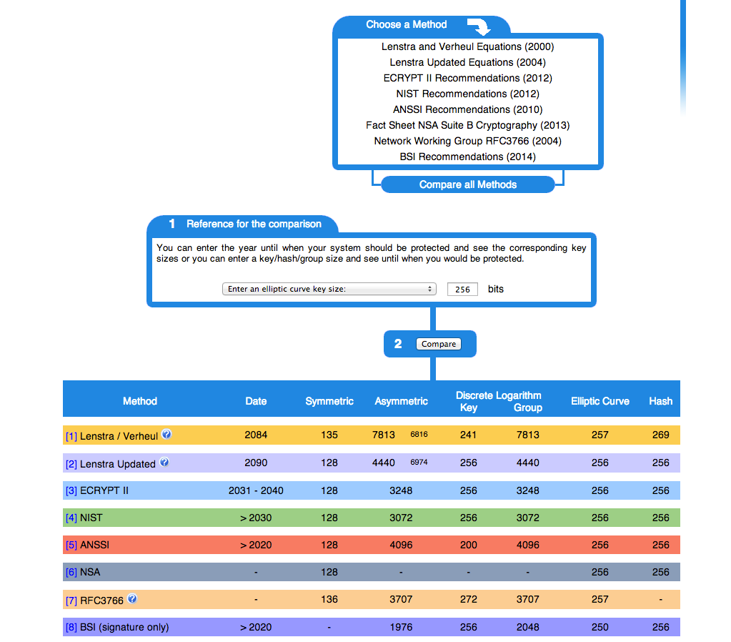

Slide 13
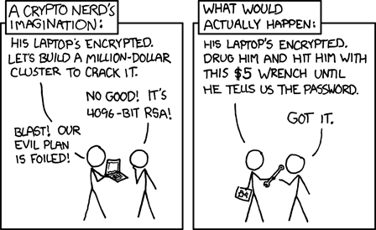
Forward Secrecy-Motivation:
Three letter agency (TLA) stores all ssl traffic
Someday TLA gains access to ssl-private key (Brute Force, Physical Force)
TLA can decrypt all stored traffic
Ramin, Daniel

Slide 14
Perfect Forward Secrecy
DHE: Diffie Hellman Ephemeral
Ephemeral: new key for each execution of a key exchange process
SSL private-Key only for authentication
Alternative new ssl private key every x days months
Pro:
Highest Security against future attacks
Contra:
Elliptic Curve
Processing costs

Slide 15
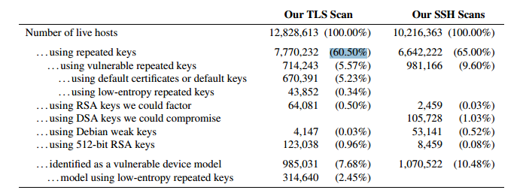
RNGs
RNGs are important.
Nadia Heninger et al / Lenstra et al
Entropy after startup: embedded devices

Slide 16
RNGs
Weak RNG
Dual EC_DRBG is weak (slow, used in RSA-toolkit)
Intel RNG ? Recommendation: add System-Entropy (Network). Entropy only goes up.
Tools (eg. HavGE http://dl.acm.org/citation.cfm?id=945516)
RTFM
when is the router key generated
Default Keys ?
Re-generate keys from time to time
Ramin, Daniel

Slide 17
Attacks
Ramin, Daniel

Slide 18
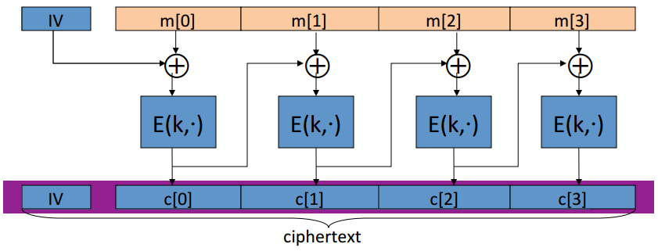
Attacks - BEAST
Browser Exploit Against SSL/TLS (BEAST) attack
Predict IV of CBC
Subsequent packet use IV that is the last cyphertext block of the previous packet
Chosen Plaintext Attack (eg. Cookie-name)
Ramin, Daniel

Slide 19

Attacks - CRIME
Compression Ratio Info-leak Made Easy (CRIME) attack
Sidechannel attack
Information based on compressed size of http requests
MITM, Bruteforce: Client Javascript to Browse to …
Compressed size smaller when secretcookie correct.

Slide 20
Cipher suites

Slide 21
Some general thoughts on settings
General
Disable SSL 2.0 (weak algorithms)
Disable SSL 3.0 (BEAST vs IE/XP)
Enable TLS 1.0 or better
Disable TLS-Compression (SSL-CRIME Attack)
Implement HSTS (HTTP Strict Transport Security)
Variant A: fewer supported clients
Variant B: more clients, weaker settings
Ramin, Daniel

Slide 22
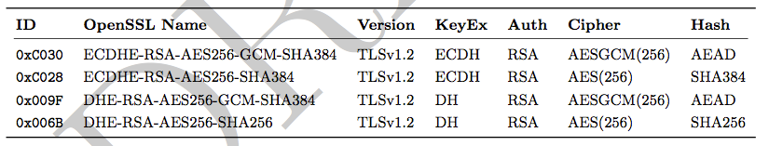
Variant A
’EECDH+aRSA+AES256:EDH+aRSA+AES256:!SSLv3’
Compatibility:
Only clients which support TLS1.2 are covered by these cipher suites (Chrome 30, Win 7 and Win 8.1, Opera 17, OpenSSL ≥ 1.0.1e, Safari 6 / iOS 6.0.1, Safari 7 / OS X 10.9)
Ramin, Daniel

Slide 23
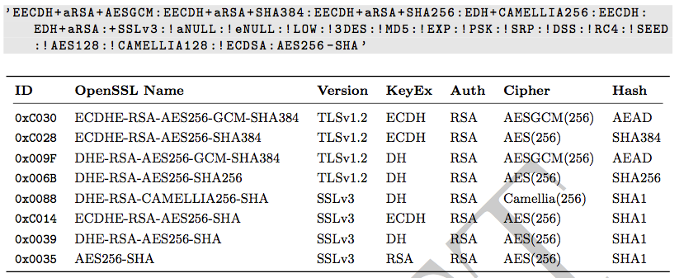
Variant B
weaker ciphers, many clients
Ramin, Daniel

Slide 24
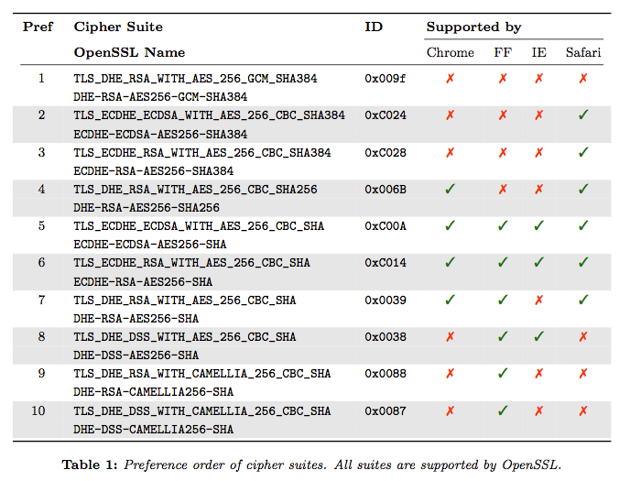
Variant B: Compatibility
Ramin, Daniel

Slide 25
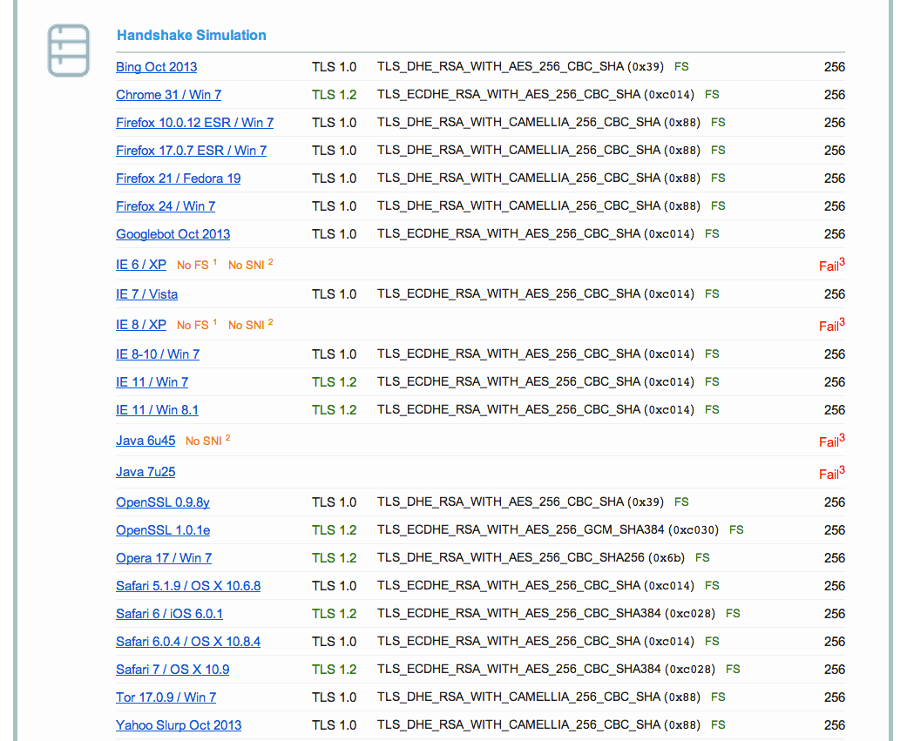
Variant B: Compatibility
End-of-life
Can be added with JCE

Slide 26
Choosing your own cipher string (1)
Rolling your own cipher suite string involves a trade-off between:
Compatibility (server <-> client), vs.
Known weak ciphers/hashes/MACs
The choice ECC or not, vs.
Support by different ssl libs (gnutls, openssl,...) vs.
Different versions of ssl libs
In case of ssl lib version issues: do you want to re-compile the whole server for a newer version?
Be aware of these issues before choosing your own cipher suite
Adi

Slide 27
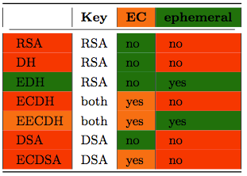
Choosing your own cipher string (2)
Complexity
Multi-dimensional optimisation
Potential future solution: generator for settings?
Adi

Slide 28
Practical settings
Aaron

Slide 29
What we have so far
Web server: Apache, nginx, IIS, lighttpd
Mail: Dovecot, cyrus, Postfix, Exim, Exchange
DBs: Mysql
Proxies
Aaron

Slide 30
What we would like to see
Mail: Exchange
SSH
VPN: OpenVPN, IPSec, PPTP, Cisco IPSec, Juniper Ipsec, L2TP, Racoon
PGP
IPMI, ILO, ...
SIP
XMPP
DBs: Postgresql, Oracle, DB2, Informix
Aaron

Slide 31
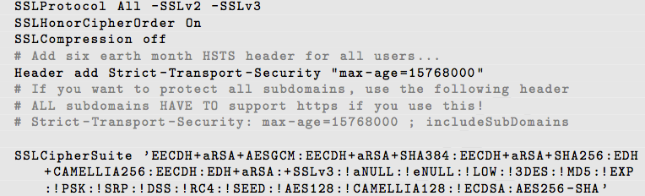
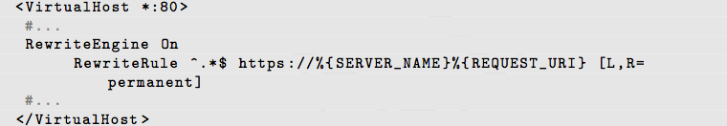
Example: Apache
Selecting cipher suites:
Additionally:
Aaron

Slide 32
Testing
Aaron

Slide 33
How to test? - Tools
openssl s_client (or gnutls-cli)
ssllabs.com: checks for servers as well as clients
xmpp.net
sslscan
SSLyze
Potential for a config file generator (as discussed)?
Aaron

Slide 34
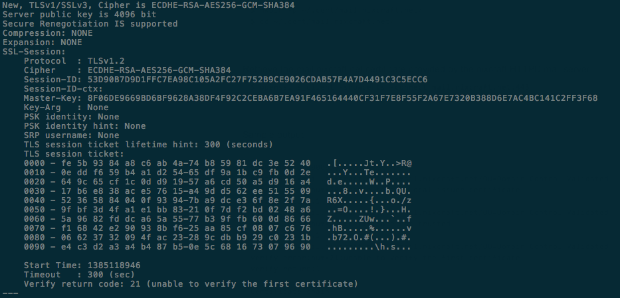
Tools: openss s_client
openssl s_client -showcerts –connect git.bettercrypto.org:443

Slide 35
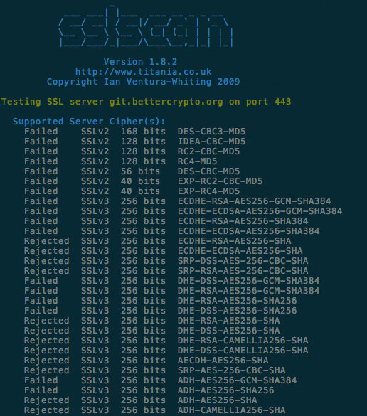
Tools: sslscan

Slide 36
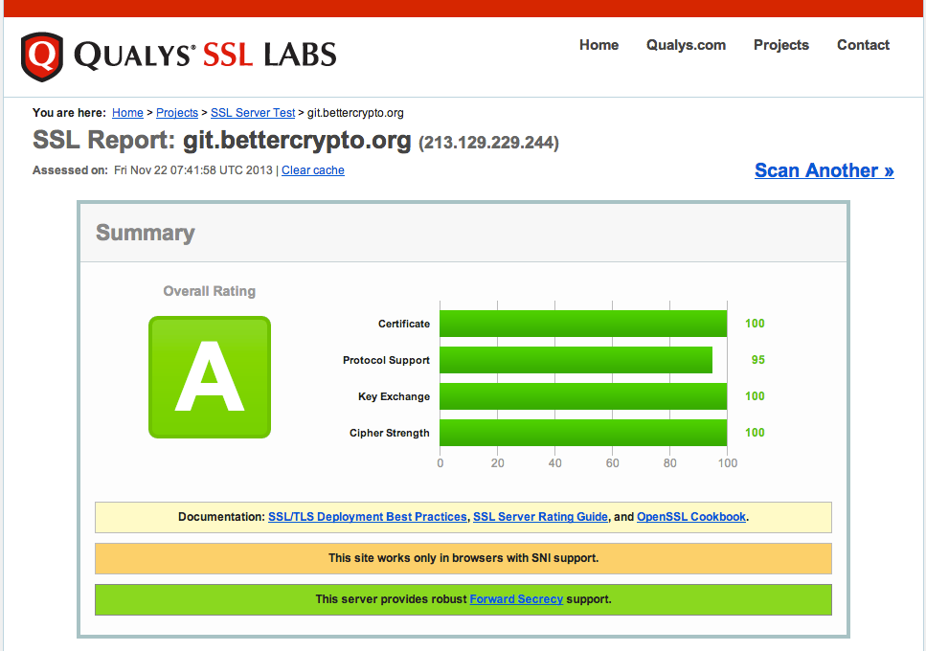
Tools: ssllabs
Aaron

Slide 37
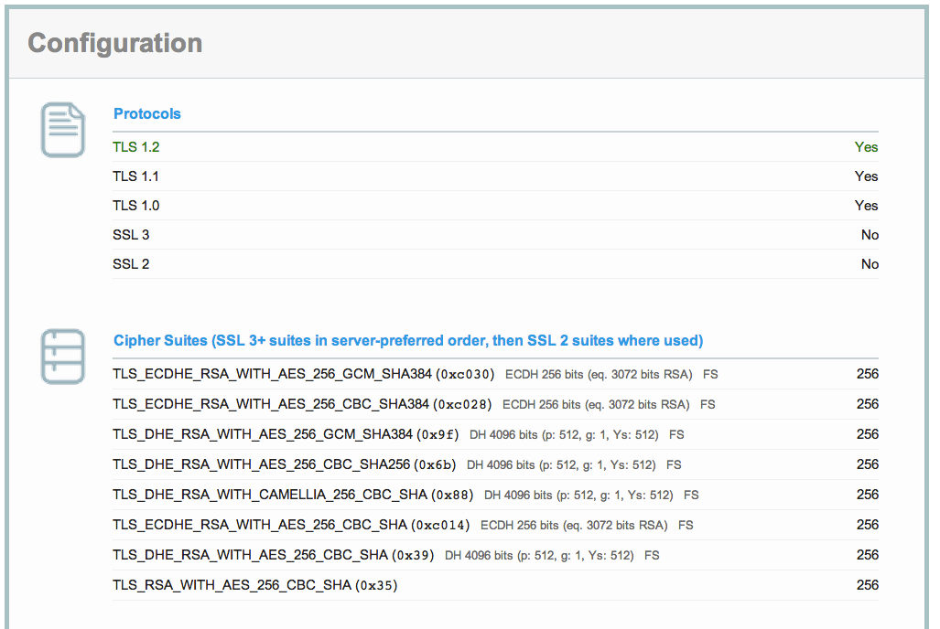
ssllabs (2)

Slide 38
Ssllabs (3)

Slide 39
Wrap-up
Aaron

Slide 40
Current state as of 2013/11/22
Solid basis with Variant (A) and (B)
ToC is in freeze state
Section „cipher suites“ still a bit messy, needs more work
Section „practical settings“ – WIP. Need more input on VPNs, PGP, SSH, IPMI, SIP, XMPP, DBs
Need to build testing setup?
Aaron

Slide 41
How to participate
We need: cryptologists, sysadmins, hackers
Read the document, find bugs
Subscribe to the mailing list
Understand the cipher strings Variant (A) and (B) before proposing some changes
If you add content to a subsection, make a sample config with variant (B)
Git repo is world-readable
We need:
Add a subsection from the TODO list
Reviewers!
Aaron

Slide 42
Links
Website: www.bettercrypto.org
Git repo: https://git.bettercrypto.org
Mailing list: http://lists.cert.at/cgi-bin/mailman/listinfo/ach
Aaron

Slide 43
Thank you!
Authors:
Wolfgang Breyha, David Durvaux, Tobias Dussa, L. Aaron Kaplan kaplan@cert.at
Manuel Koschuch, Daniel Kovacic, Adi Kriegisch adi@kriegisch.at
Christian Mock, Ramin Sabet , Aaron Zauner <azet.org>
Pepi Zawodsky pepi@maclemon.at

